Slide 1
Традиции высшей пробы
www.ezocm.ru

Slide 2
Production and technical facilities of JSC “ENFMPP” in manufacturing of finished products

Slide 3
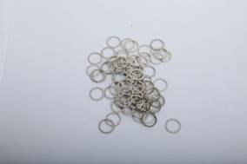
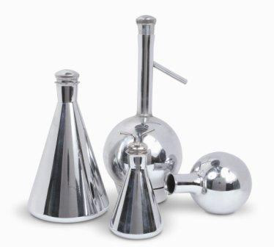
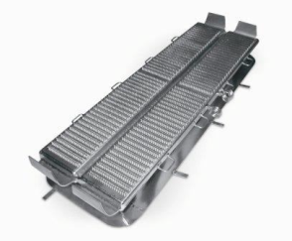
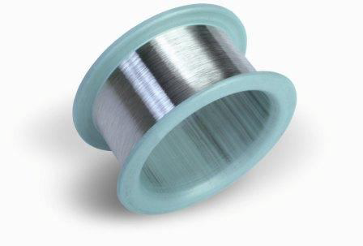
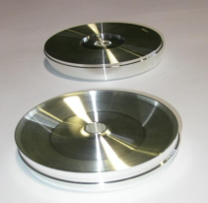
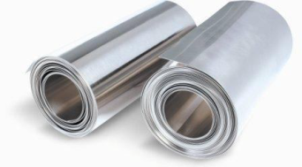
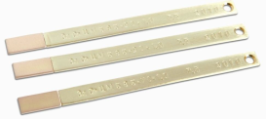
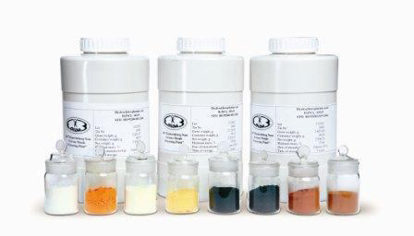
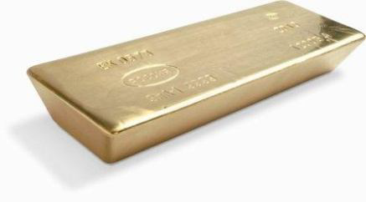
Main products of JSC “ENFMPP”
Catalyst and catching gauzes
Contact Details
Glass melters and bushings
Labware
Wire
Products of technical application
Flat-rolled Products
Certified Reference Materials and test materials
Refined metals
Chemical compounds

Slide 4
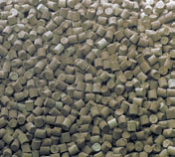
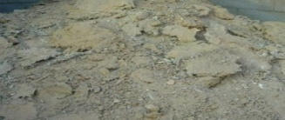
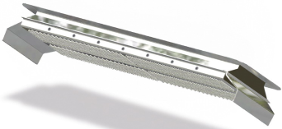
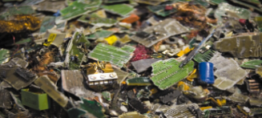
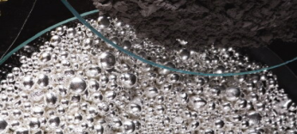
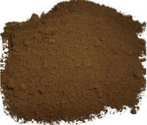
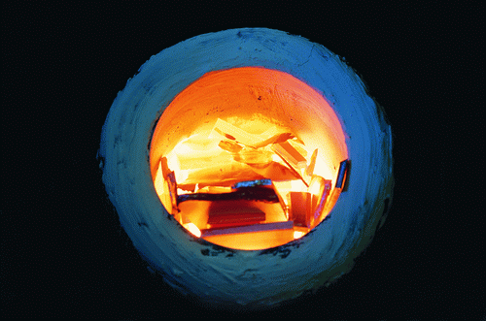
Main kinds of processed raw materials
Scrap of catalyst and catching gauzes
Catalysts used in nitrogen industry
Wall lining layers of glass-melting equipment
Wall lining layers of glass-melting equipment
Electronic wastes concentrates
Stream gold
PGM concentrates
Scrap containing precious metals

Slide 5
Chemical composition of alloys that are used in bushings and glass melters
Elements | Requirements | PtRh-7 | PtRh-10 | PtRh-20 | PtRh-35
 |  | Contents in facts
Fe | 0,025 | 0,0036 | 0,0032 | 0,0034 | 0,0031
Мg | 0,015 | 0,0025 | 0,0020 | 0,0024 | 0,0014
Si | 0,005 | 0,0005 | 0,0005 | 0,0006 | 0,0008
Аl | 0,005 | 0,0005 | 0,0005 | 0,0009 | 0,0009
As | 0,005 | 0,0010 | 0,0010 | 0,0009 | 0,0009
Ni | ∑ ≤ 0,025 | ∑ 0,0030 | ∑ 0,0037 | ∑ 0,0043 | ∑ 0,0038
Cu
Pb | 0,005 | 0,0003 | 0,0003 | 0,0005 | 0,0005
Zn | ∑ ≤ 0,02 | ∑ 0,0007 | ∑ 0,0006 | ∑ 0,0009 | ∑ 0,0010
Sn

Slide 6
Electron-beam remelting
Refinement | Scrap of catalyst and catching gauzes Scrap of glass melters and bushings Iridium scrap
 | REFINEMENT efficiency
Manufacturing of finished products | Glass melters and bushings Wire Iridium targets Iridium crucibles for industrial use Electrodes for sparking plugs
 | HIGH QUALITY OF SEMI-FINISHED PRODUCTS

Slide 7
Manufacturing of semi-finished products
Electron-beam melting
Vacuum-induction melting
Melting by semicontinuous casting method
Open (air) induction melting
Melting by method of reversed draft
Monocrystal remelting

Slide 8
Equipment modernization
System of product estimation in precious metals loses
Upgrading of the present production methods
Technologic service
New production methods development
Team of professionals

